Slide 4
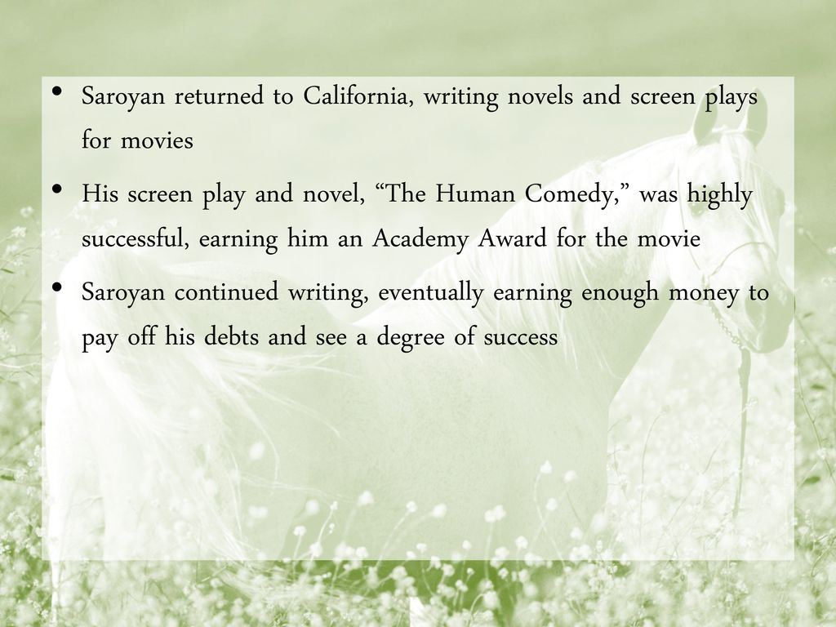

Slide 10
STARTING JOURNESTARTING JOURNEY:
1976 (FROM PLYMOUTH)
ACCOMPANIED BY WIFE MARY,SON JONATHAN,DAUGHTER SUZZANE
Y:
1976 (FROM PLYSTARTING JOURNEY:
1976 (FROM PLYMOUTH)
ACCOMPASTARTING JOURNEY:
1976 (FROM PLYMOUTH)
ACCOMPANIESTARTING JOURNEY:
1976 (FROM PLYMOUTH)
ACCOMPANIED BY WIFE MARY,SON JONATHAN,DAUGHTER SUZZANE
D BY WIFE MARY,SON JONATHAN,DAUGHTER SUZZANE
NIED BY WIFE MARY,SON JONATHAN,DAUGHTER SUZZANE
MOUTH)
ACCOMPANIED BY WIFE MARY,SON JONATHAN,DAUGHTER SUZZANE

Slide 14
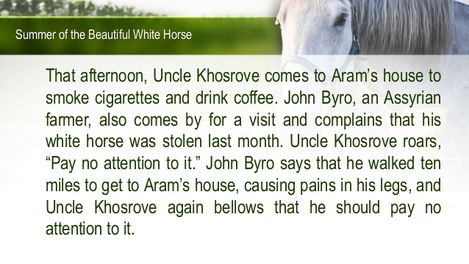

Slide 21
https://www.youtube.com/watch?v=lffY0Vr6fsM

